Slide 1
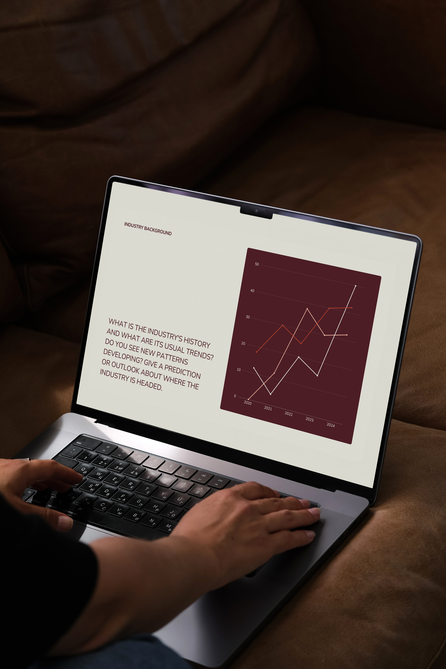
Philippine Airlines Passenger Review Analysis
Milestone 2 Report
Prepared by: Group 4
An in-depth analysis of 891 passenger reviews covering seat comfort, cabin staff service, food & beverages, inflight entertainment, ground service, value for money, Wi-Fi connectivity, and recommendation drivers.

Slide 2
Dataset Overview
Dataset: 891 passenger reviews across 15 columns.
Scope covers Seat Comfort, Cabin Staff Service, Food & Beverages, Inflight Entertainment, Ground Service, Value for Money, Wi-Fi/Connectivity, and Recommendation.

Slide 3
What This Analysis Delivers
For Decision-Makers
Clear priorities for resource allocation
Evidence to support strategic investments
Understanding of what impacts recommendations most
For Different Departments
Marketing: Highlight PAL's strongest attributes
Operations: Address critical service weaknesses
Customer Service: Focus on experience drivers
Bottom Line Impact
Targeted improvements that increase recommendations
Better passenger experience across all touchpoints
Stronger competitive position in the market

Slide 4
Goal: Identify strengths, weaknesses, and key drivers of passenger satisfaction for PAL Airlines 2019 - 2022
Philippine Airlines Review Analysis
GROUP4 | MILESTONE 2

Slide 5
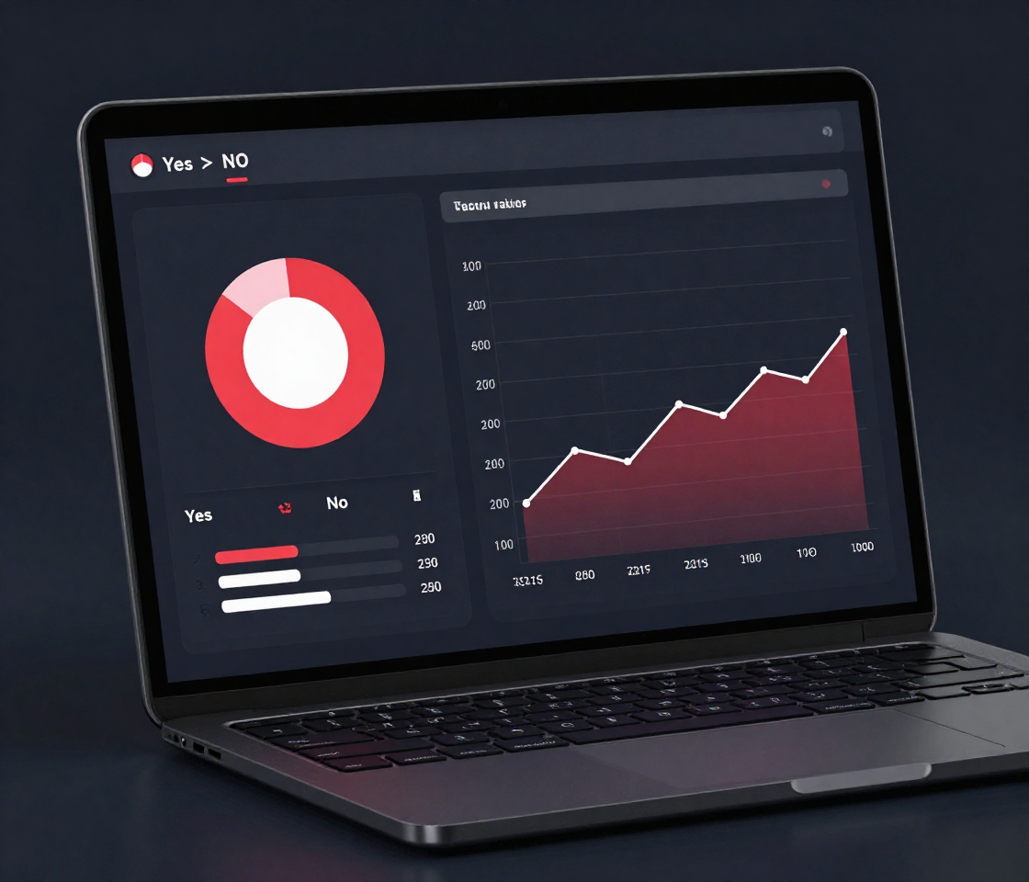
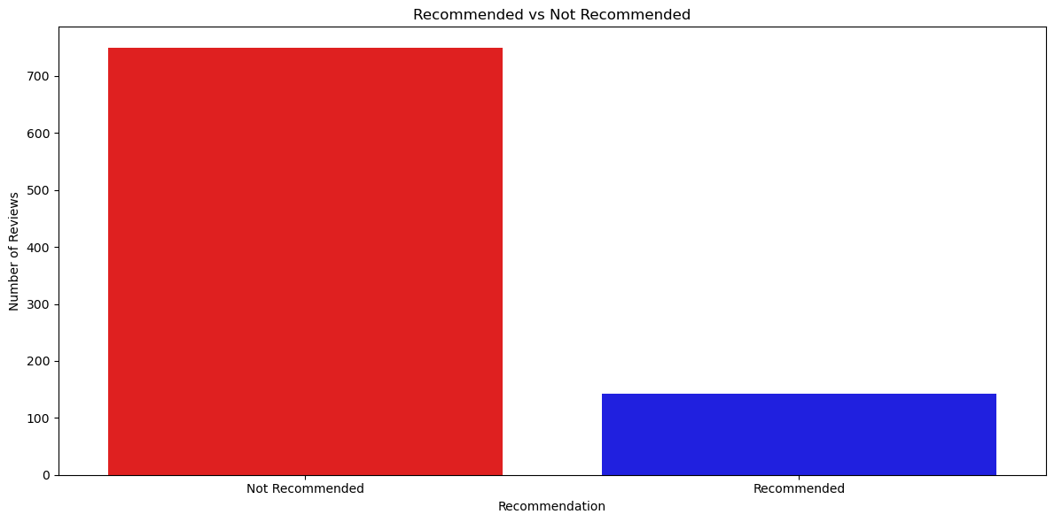
Recommendation
Breakdown
Yes vs. No Recommendation Patterns
Passengers were asked whether they would recommend Philippine Airlines. The majority responded No, indicating overall dissatisfaction. Travelers in Business and First Class were more likely to recommend the airline, while Economy passengers showed the lowest recommendation rates. Recommendation rates also varied over time, with a noticeable decline in recent review periods, suggesting worsening passenger experience trends.

Slide 6
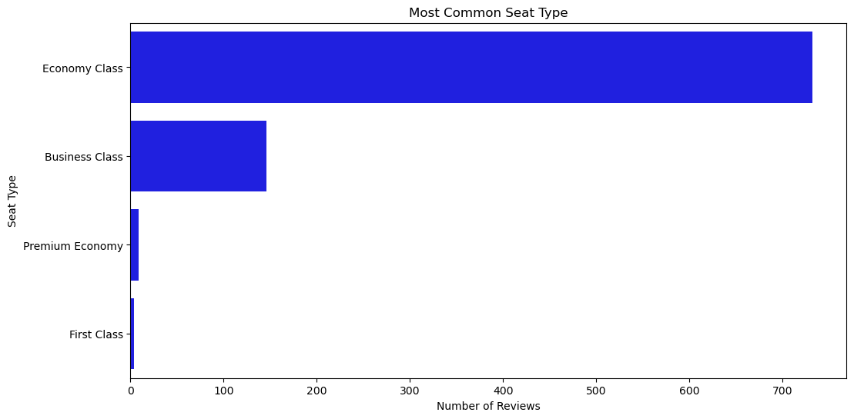
Seat Category

Slide 7
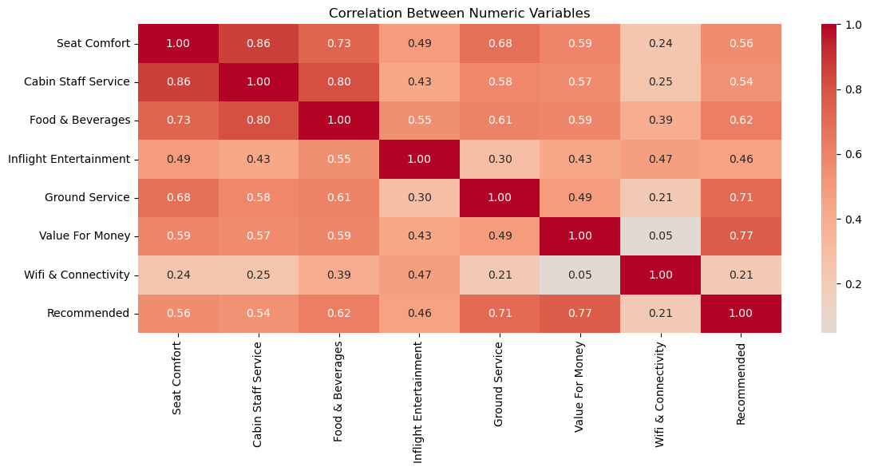
Strongest Rating Relationships
Key findings: Seat Comfort vs Cabin Staff Service (0.86) and Cabin Staff Service vs Food & Beverages (0.80) show the strongest links. Value for Money vs Recommended (0.77) and Ground Service vs Recommended (0.71) are top drivers of satisfaction. Wi-Fi & Connectivity shows the weakest correlations across all categories.

Slide 8
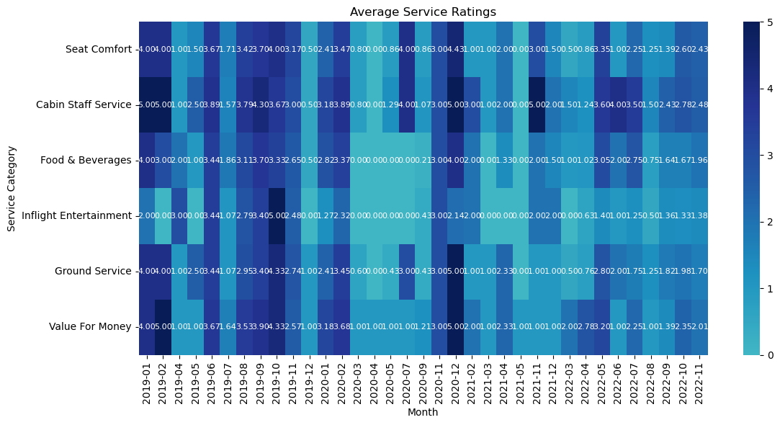
The heatmap shows that airline service ratings varied across categories and time. Cabin staff service and seat comfort consistently scored higher, suggesting passengers valued these aspects most. In contrast, food, beverages, and inflight entertainment often lagged, reflecting weaker satisfaction in non‑essential services. Notably, ratings dipped around mid‑2020, likely due to pandemic disruptions, but recovered by late 2021–2022, with improvements in ground service and value for money indicating renewed customer confidence.

Slide 9
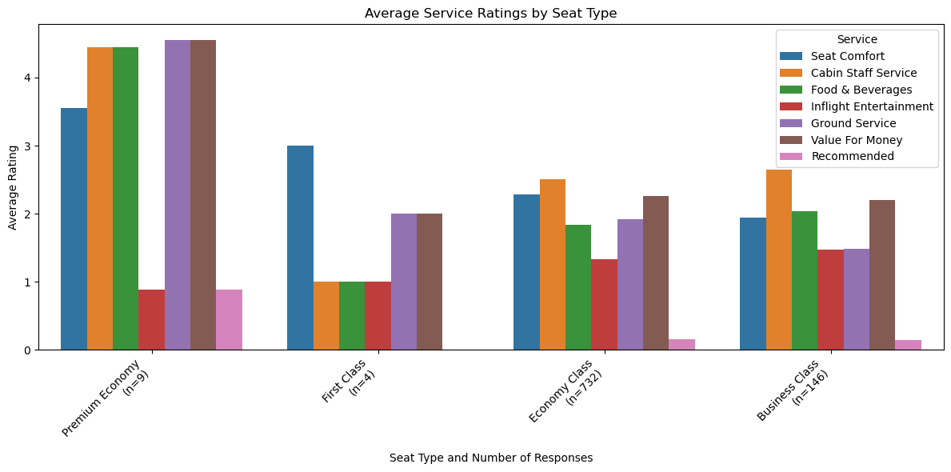
Seat Type Comparison
Economy, Business, Premium Economy & First Class
Premium Economy reports higher satisfaction across almost all service dimensions except for inflight entertainment, consistently outperforming other cabin classes. Economy Class shows the greatest variability in ratings, reflecting inconsistent passenger experiences. Both Premium Economy and First Class have smaller sample sizes, which limits the generalizability of their results.

Slide 10
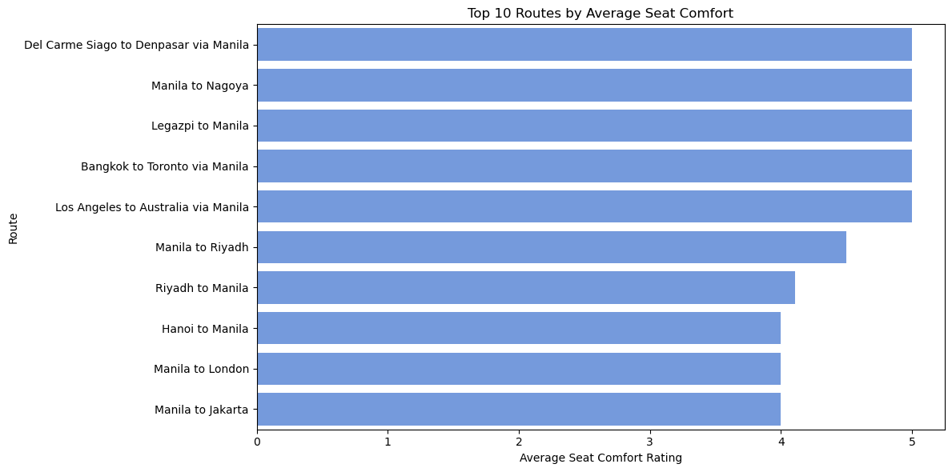
Route Analysis
Seat Comfort by Route & Top Aircraft Performance
Route-level analysis reveals significant variation in seat comfort scores across destinations. Long-haul international routes tend to show lower comfort ratings, while select regional routes perform better. Aircraft type plays a key role: wide-body aircraft consistently receive higher ratings. Top-performing aircraft models show stronger overall satisfaction, reinforcing the link between equipment and passenger experience.

Slide 11
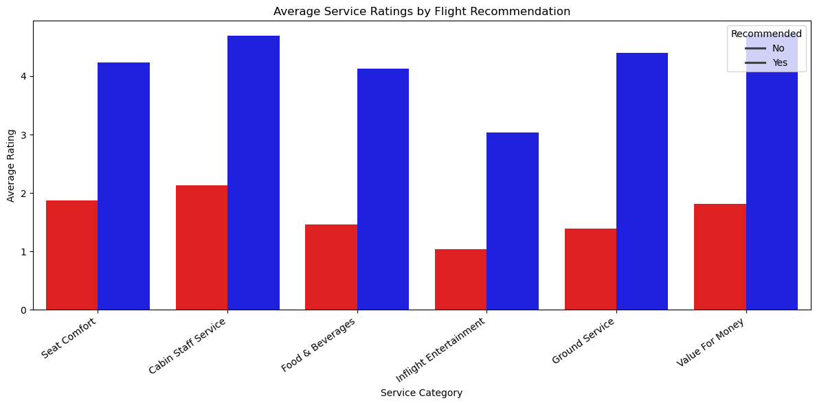
Overall Ratings
Rating Distribution by Service Category
Cabin Staff Service and Seat Comfort earn the highest ratings, clustering near 4–5 on recommended flights. Food & Beverages and Inflight Entertainment sit mid‑range, while Ground Service and Value for Money show the widest variation, reflecting inconsistency across routes. Strong staff service and comfort emerge as the most reliable drivers of positive recommendations.

Slide 12
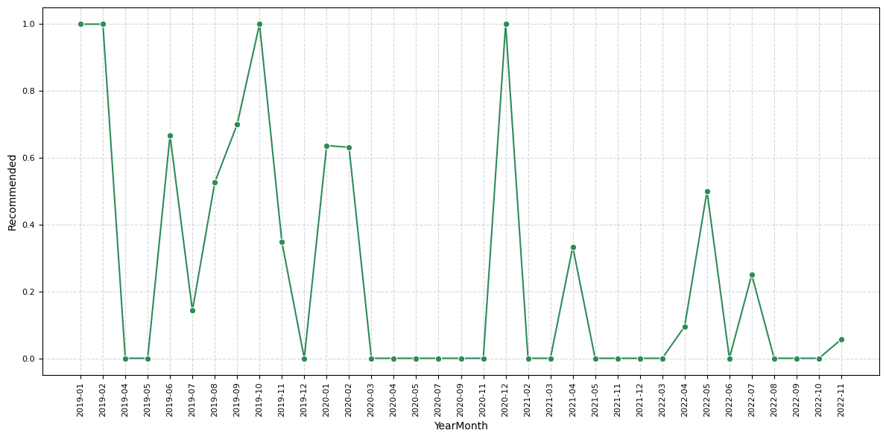

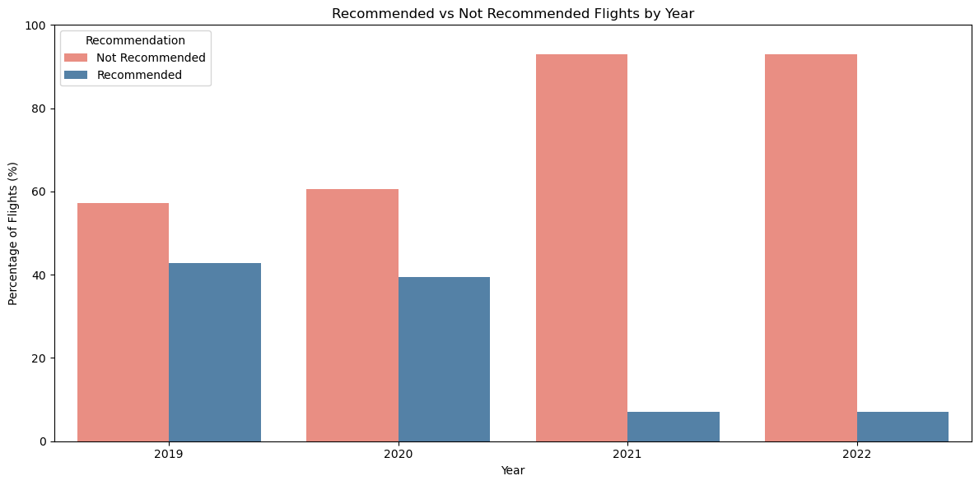
Trends
Over Time
Rating Patterns & Recommendation Trends
The dataset reflects how external shocks — particularly the pandemic — reshaped passenger perceptions. Core service elements like Ground Service and Value for Money suffered during and after 2020, dragging down recommendation rates. Meanwhile, persistent dissatisfaction with connectivity and entertainment highlights structural issues that predate and outlast the pandemic. Airlines that invested in recovery efforts post‑2021 show gradual improvement, but uneven review volume makes trend reliability weaker in earlier years.

Slide 13
Conclusion
Philippine Airlines Passenger Review Analysis — Key Findings
STRENGTHS
WEAKNESSES
Wi-Fi & inflight entertainment scored lowest; weak recommendation links
Strong cabin staff & seat comfort ratings; high correlation (r=0.86)
OUTCOME
RECOMMEND
Prioritize value for money, ground service, Wi-Fi & food improvements
Evidence-based insights from 891 reviews across 15 attributes

Slide 14
Recommendations
Immediate Priorities
Address value for money and ground service issues
Improve Wi-Fi and entertainment offerings
Enhance food and beverage quality
Strategic Focus
Leverage cabin staff excellence as a competitive advantage
Maintain seat comfort standards across fleet
Tailor improvements by passenger segment and route
Measuring Success
Track recommendation rates over time
Monitor ratings in targeted improvement areas
Compare performance across key routes

Slide 15
DROP INDEX COLUMN
1
Data Cleaning
STANDARDIZE NAMES
2
ENCODE RECOMMENDED
3
5 Preprocessing Steps Applied
The raw dataset of 891 reviews underwent systematic cleaning to ensure data quality and consistency. Key transformations included removing redundant fields, standardizing naming conventions, encoding categorical variables, handling missing values, and enforcing correct data types across all rating columns.
FILL MISSING AIRCRAFT
4
CONVERT TO NUMERIC
5

Slide 16

DROP INDEX COLUMN
1
2
3
4
5

Slide 17

DROP INDEX COLUMN
1
STANDARDIZE NAMES
2
3
4
5

Slide 18
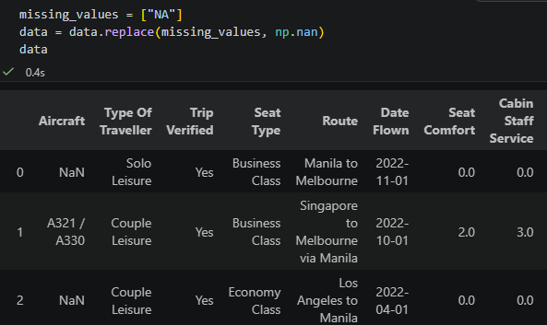
DROP INDEX COLUMN
1
STANDARDIZE NAMES
2
ENCODE RECOMMENDED
3
4
5

Slide 19
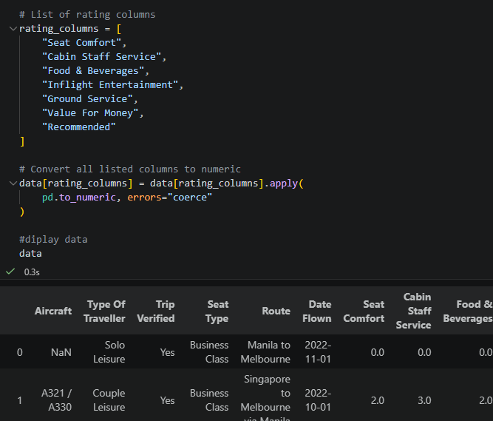
DROP INDEX COLUMN
1
STANDARDIZE NAMES
2
ENCODE RECOMMENDED
3
FILL MISSING AIRCRAFT
4
5

Slide 20

DROP INDEX COLUMN
1
STANDARDIZE NAMES
2
ENCODE RECOMMENDED
3
FILL MISSING AIRCRAFT
4
CONVERT TO NUMERIC
5

